Slide 1
Room
Week 8
Advanced Native Mobile Programming
Teknik Informatika - Universitas Surabaya

Slide 2
Before We Begin
SQLite and Room Library
Room Annotation
Data Access Object
Room Database
Kotlin Coroutine

Slide 3
SQLite
SQLite is an open-source relational database
Embedded by default
SQlite is Sandbox
SQlite is low-level access

Slide 4
0.
The Concept

Slide 5
Room Persistence Library
Abstraction layer over SQLite
Compile-time verification of SQL queries.
Convenience annotations that minimize repetitive and error-prone boilerplate code.
Streamlined database migration paths.
Room needs at least three file: The Entity class model, the DAO, and the database class

Slide 6
Room Annotation
Its a way to mark specific part of codes that handleable by Room library
Room provide a lot of annotation to speed up project programming times
Example of annotation: @Query -> define custom query to db @Entity -> mark the class as table on db @Insert -> mark the next function as insert action to db, and so on

Slide 7
DAO (Data Access Object)
DAO provides methods that offer abstract access to your app's database.
At compile time, Room automatically generates implementations of the DAOs that you define.

Slide 8
Room Database
Base class for all Room databases. All classes that are annotated with Database must extend this class.
Within this class, you may define database version, migration policy, define tables registered on database, database name, and so on

Slide 9
Kotline Coroutine
Coroutine manages your long-running tasks in the background thread that might block the main thread and cause your app to freeze
Coroutines can easily switch threads at any time and pass results back to the original thread

Slide 10
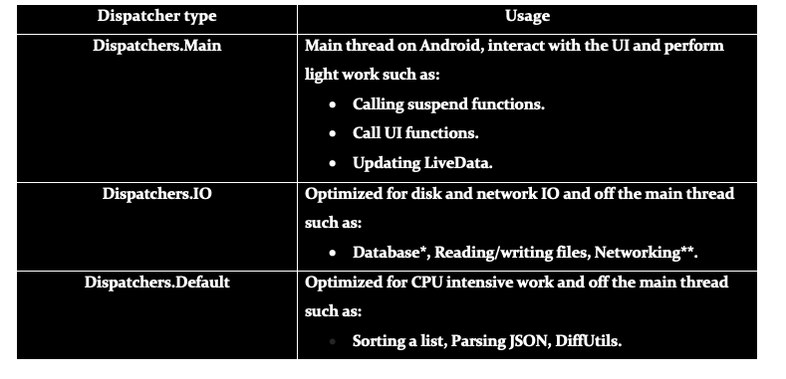
Kotline Coroutine Dispatcher
There are three different threads in coroutines

Slide 11
1.
Setting Up
New Project and Gradle Setting

Slide 12
Create New Project
Start new Android Studio Project with project name “TodoApp”
Set github account for this project, and make your first commit and push

Slide 13
Setting Up
First we need to setting up dependencies and gradle. Open build.gradle (project)
Add these lines at the topmost:
buildscript {
repositories {
google()
}
dependencies {
classpath "androidx.navigation:navigation-safe-args-gradle-plugin:2.4.2"
}
}

Slide 14
Setting Up
Next open build.gradle (Module), add following setting (blue text)
plugins {
id 'com.android.application'
id 'kotlin-android’
id 'kotlin-kapt'
id 'androidx.navigation.safeargs.kotlin'
}

Slide 15
Setting Up
Still in the same file, add following dependencies (modify the version number as suggested by AndStud)
implementation 'androidx.navigation:navigation-fragment-ktx:2.4.2'
implementation 'androidx.navigation:navigation-ui-ktx:2.4.2'
implementation 'androidx.room:room-runtime:2.4.2'
implementation 'androidx.room:room-ktx:2.4.2'
kapt "androidx.room:room-compiler:2.4.2"
Room Library
These dependencies are mandatory to work with room library, especially in the Kotlin environment

Slide 16
2.
Fragments

Slide 17
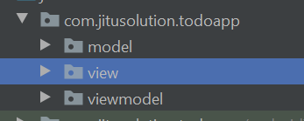
MVVC Package
Start by create three new package (right click on current package > new >package file). Name those packages as “model”, “view”, “viewmodel”
Move “MainActivity” into “view” package
Execute Build > Rebuild Project

Slide 18
Fragments
Todo App only requires two fragment. One for display list of todo, and other for create new todo.
Also we need two drawable vector asset for FAB button and edit button
Create those fragments inside view package. Name it as “TodoListFragment” and “CreateTodoFragment”

Slide 19
Clean Up Fragments
Clean up unnecessary codes in both Fragments:
Delete everything except onCreateView method
Add override onViewCreated

Slide 20
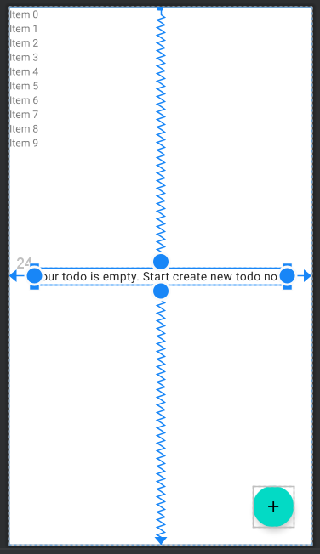
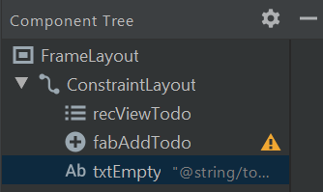
Fragments Layout
TodoList Fragment Layout contains RecyclerView, FloatingAction Button (with edit icon), and single text view

Slide 21
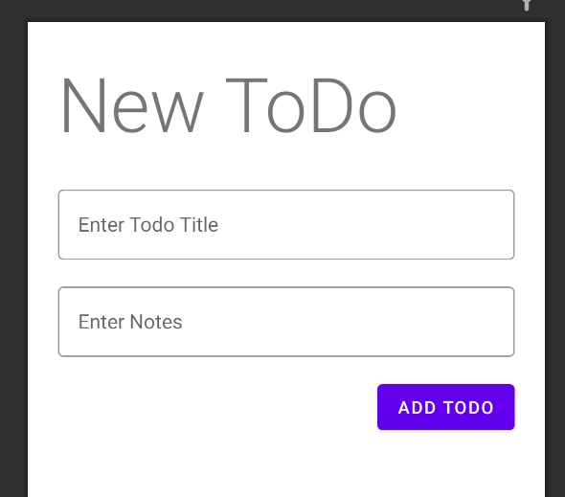
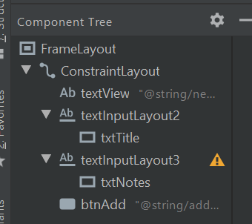
Fragments Layout - CreateTodoFragment

Slide 22
Item Todo Layout
We need another layout for RecyclerView List to display all todo’s
Right click on res > layout > new > layout resource file
Name it as todo_item_layout

Slide 23
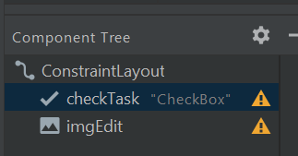
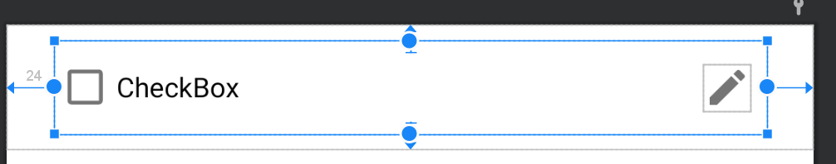
Fragments Layout - ItemTodoLayout
imgEdit requires “pencil”/ edit icon. You may create new on with drawable vector asset

Slide 24
3.
Navigation Graph

Slide 25
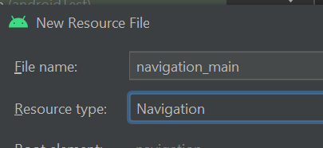
Navigation Graph
Right click on res > new > Android Resource File
Set file name as “navigation_main”
Set resource type as “Navigation”
Press OK

Slide 26
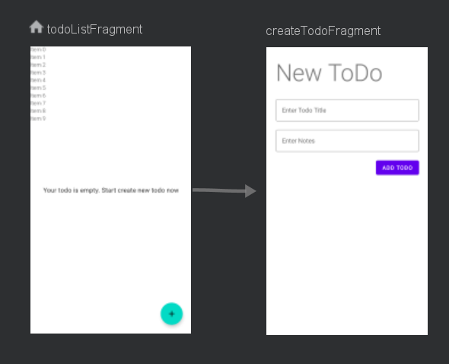
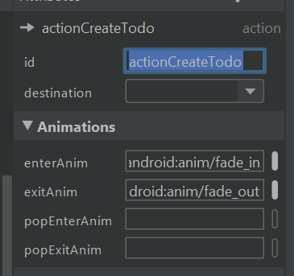
Draw Navigation Graph
Action (arrow) properties

Slide 27
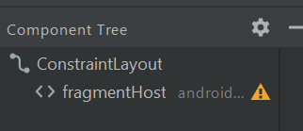
Main Activity Layout
Drag and drop NavHost Fragment into Main Activity layout
Choose navigation_main

Slide 28
4.
The Model

Slide 29
Model.kt
Right click on “Model” package and create new Kotlin file “Model.kt”
Create Todo class
data class Todo(
var title:String, var notes:String )

Slide 30
Implement Room
Add “entity” annotation on the Todo class to marks this class as an entity.
This class will have a mapping SQLite table in the database

Slide 31
Implement Room
Entity Annotation
Room will create “todo” table in database
@Entity
data class Todo(
@ColumnInfo(name="title")
var title:String,
@ColumnInfo(name="notes")
var notes:String
) {
@PrimaryKey(autoGenerate = true)
var uuid:Int =0
}
ColumInfo Annotation
specify a column name for the field in table database
PrimaryKey Annotation
Each entity class requires one primary key. Autogenerate config set to true to let SQLite generate the unique id

Slide 32
DAO (Data Access Object)
Right click on model package > new > Kotlin file/class
Pick interface
Set it name as TodoDao

Slide 33
Implement Room Dao
Dao Annotation
Marks the class as a Data Access Object. Data Access Objects are the main classes where you define your database interactions. They can include a variety of query methods.
@Dao
interface TodoDao {
@Insert(onConflict = OnConflictStrategy.REPLACE)
fun insertAll(vararg todo:Todo)
@Query("SELECT * FROM todo")
fun selectAllTodo(): List<Todo>
@Query("SELECT * FROM todo WHERE uuid= :id")
fun selectTodo(id:Int): Todo
@Delete
fun deleteTodo(todo:Todo)
}
Insert Annotation
The implementation of the method will insert its parameters into the database.

Slide 34
Implement Room Dao
Free Query
This query is verified at compile time by Room to ensure that it compiles fine against the database.
@Dao
interface TodoDao {
@Insert(onConflict = OnConflictStrategy.REPLACE)
fun insertAll(vararg todo:Todo)
@Query("SELECT * FROM todo")
fun selectAllTodo(): List<Todo>
@Query("SELECT * FROM todo WHERE uuid= :id")
fun selectTodo(id:Int): Todo
@Delete
fun deleteTodo(todo:Todo)
}
Free Query with Parameter
The arguments of the method will be bound to the bind arguments in the SQL statement.

Slide 35
Todo Database with Singleton Concept
Right click on model package > new > Kotlin file/class
Pick Class
Set it name as TodoDatabase

Slide 36
Implement Room Database
@Database(entities = arrayOf(Todo::class), version = 1)
abstract class TodoDatabase:RoomDatabase() {
abstract fun todoDao(): TodoDao
companion object {
}
}
Database Annotation
Marks a class as a RoomDatabase. Entities config is used to put entity (table) inside database. Version is used for migration purpose.

Slide 37
Implement Singleton
Volatile
meaning that writes to this field are immediately made visible to other threads
companion object {
@Volatile private var instance: TodoDatabase ?= null
private val LOCK = Any()
private fun buildDatabase(context:Context) =
Room.databaseBuilder(
context.applicationContext,
TodoDatabase::class.java,
"newtododb").build()
}
Database Builder
Database Builder requires context, database class, and database name as String

Slide 38
Implement Singleton
Singleton Implementation
restricts the instantiation of a class to one "single" instance
companion object {
. . .
operator fun invoke(context:Context) {
if(instance!=null) {
synchronized(LOCK) {
instance ?: buildDatabase(context).also {
instance = it
}
}
}
}
}
Synchronized
A thread that enters a synchronized method obtains a lock (an object being locked is the instance of the containing class) and no other thread can enter the method until the lock is released.

Slide 39
5.
ViewModel

Slide 40
Create ViewModels
Create viewmodel for both fragments
Right click on viewmodel package new > Kotlin class/file
Name it as ListTodoViewModel
Choose class, press OK

Slide 41
TodoListViewModel
class ListTodoViewModel(application: Application)
:AndroidViewModel(application), CoroutineScope {
val todoLD = MutableLiveData<List<Todo>>()
val todoLoadErrorLD = MutableLiveData<Boolean>()
val loadingLD = MutableLiveData<Boolean>()
private var job = Job() override val coroutineContext: CoroutineContext
get() = job + Dispatchers.IO
Coroutine Scope
Its a way to provide control for coroutine
Dispatcher
tell you, on which thread should I run this block of code. i.e(Main, IO, Default)

Slide 42
TodoListViewModel
Launch
launch() function to create a job. The launch is known as fire and forgets builder.
fun refresh() {
loadingLD.value = true
todoLoadErrorLD.value = false
launch {
val db = Room.databaseBuilder(
getApplication(),
TodoDatabase::class.java, "newtododb").build()
todoLD.postValue(db.todoDao().selectAllTodo())
}
}
postValue
Used postValue to asynchronously handle expected result from DAO.
Call Room DAO
Todo list livedata is populated with data selected from Database.

Slide 43
TodoListViewModel
fun clearTask(todo: Todo) {
launch {
val db = Room.databaseBuilder(
getApplication(),
TodoDatabase::class.java, "newtododb").build()
db.todoDao().deleteTodo(todo)
todoLD.postValue(db.todoDao().selectAllTodo())
}
}
Delete ToDo
Clear task simply delete single todo based on the selected object

Slide 44
Create DetailTodoViewModels
Right click on viewmodel package new > Kotlin class/file
Name it as DetailTodoViewModel
Choose class, press OK

Slide 45
DetailTodoListViewModel
class DetailTodoViewModel(application: Application)
:AndroidViewModel(application), CoroutineScope {
private val job = Job()
fun addTodo(list:List<Todo>) {
launch {
val db = Room.databaseBuilder(
getApplication(), TodoDatabase::class.java,
"newtododb").build()
db.todoDao().insertAll(*list.toTypedArray())
}
}
*list
Convert individual element of list into its individual object (Todo object) and set it as separated parameter

Slide 46
DetailTodoListViewModel
override val coroutineContext: CoroutineContext
get() = job + Dispatchers.IO

Slide 47
6.
View

Slide 48
Open CreateTodoFragment
Add following viewmodel instance
private lateinit var viewModel:DetailTodoViewModel
override fun onViewCreated(view: View, savedInstanceState: Bundle?) {
super.onViewCreated(view, savedInstanceState)
viewModel =
ViewModelProvider(this).get(DetailTodoViewModel::class.java)
val btnAdd = view.findViewById<Button>(R.id.btnAdd)
btnAdd.setOnClickListener {
}
}

Slide 49
Open CreateTodoFragment
btnAdd.setOnClickListener { val txtTitle = view.findViewById<EditText>(R.id.txtTitle)
val txtNotes = view.findViewById<EditText>(R.id.txtNotes)
var todo = Todo(txtTitle.text.toString(), txtNotes.text.toString())
val list = listOf(todo)
viewModel.addTodo(list)
Toast.makeText(view.context, "Data added", Toast.LENGTH_LONG).show()
Navigation.findNavController(it).popBackStack()
}

Slide 50
Create Adapter for RecyclerView
Right click on view package new > Kotlin class/file
Name it as TodoListAdapter
Choose class, press OK

Slide 51
Create Adapter
class TodoListAdapter(val todoList:ArrayList<Todo>)
:RecyclerView.Adapter<TodoListAdapter.TodoViewHolder>() {
class TodoViewHolder(var view:View): RecyclerView.ViewHolder(view)
override fun onCreateViewHolder(parent: ViewGroup, viewType: Int): TodoViewHolder { }
override fun onBindViewHolder(holder: TodoViewHolder, position: Int)
{ }
override fun getItemCount(): Int { }
}

Slide 52
Create Adapter
override fun onCreateViewHolder(parent: ViewGroup, viewType: Int): TodoViewHolder {
val inflater = LayoutInflater.from(parent.context)
val view = inflater.inflate(R.layout.todo_item_layout, parent, false)
return TodoViewHolder(view)
}
override fun getItemCount(): Int {
return todoList.size
}

Slide 53
Create Adapter
override fun onBindViewHolder(holder: TodoViewHolder, position: Int) {
var checktask = holder.view.findViewById<CheckBox>(R.id.checkTask)
checktask.text = todoList[position].title
}
fun updateTodoList(newTodoList: List<Todo>) {
todoList.clear()
todoList.addAll(newTodoList)
notifyDataSetChanged()
}

Slide 54
Open TodoListFragment
Add following viewmodel instance & adapter
private lateinit var viewModel:ListTodoViewModel
private val todoListAdapter = TodoListAdapter(arrayListOf())
override fun onViewCreated(view: View, savedInstanceState: Bundle?) {
super.onViewCreated(view, savedInstanceState)
viewModel = ViewModelProvider(this).get(ListTodoViewModel::class.java)
viewModel.refresh()
var recViewTodo = view.findViewById<RecyclerView>(R.id.recViewTodo)
recViewTodo.layoutManager = LinearLayoutManager(context)
recViewTodo.adapter = todoListAdapter
}

Slide 55
Open TodoListFragment
override fun onViewCreated(view: View, savedInstanceState: Bundle?) {
super.onViewCreated(view, savedInstanceState)
. . .
fabAddTodo.setOnClickListener {
val action = TodoListFragmentDirections.actionCreateTodo()
Navigation.findNavController(it).navigate(action)
}
observeViewModel()
}

Slide 56
ObserveViewModel
fun observeViewModel() {
viewModel.todoLD.observe(viewLifecycleOwner, Observer {
todoListAdapter.updateTodoList(it)
var txtEmpty = view?.findViewById<TextView>(R.id.txtEmpty)
if(it.isEmpty()) {
txtEmpty?.visibility = View.VISIBLE
} else {
txtEmpty?.visibility = View.GONE
}
})
}

Slide 57
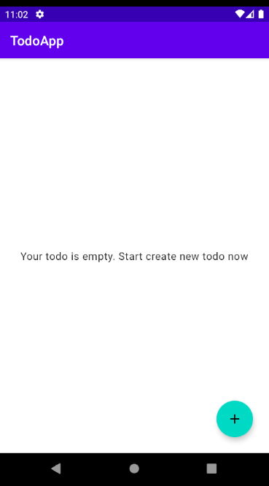
Result
At first its empty

Slide 58
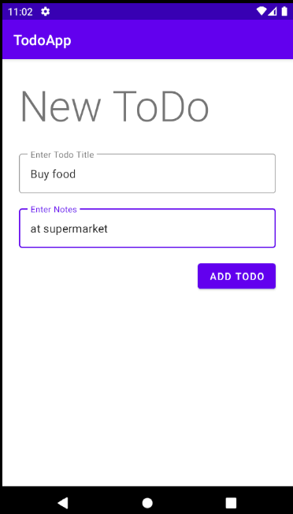
FAB
Click FAB and add new Todo

Slide 59
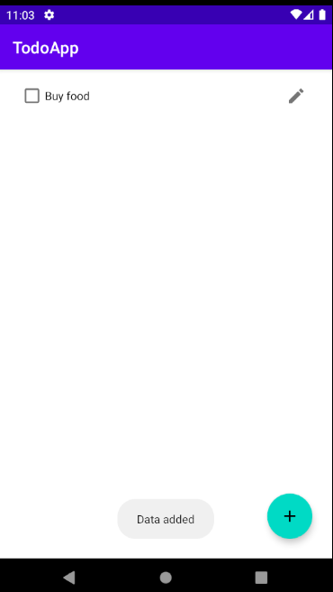
New Todo Added
Displayed as checkable Task

Slide 60
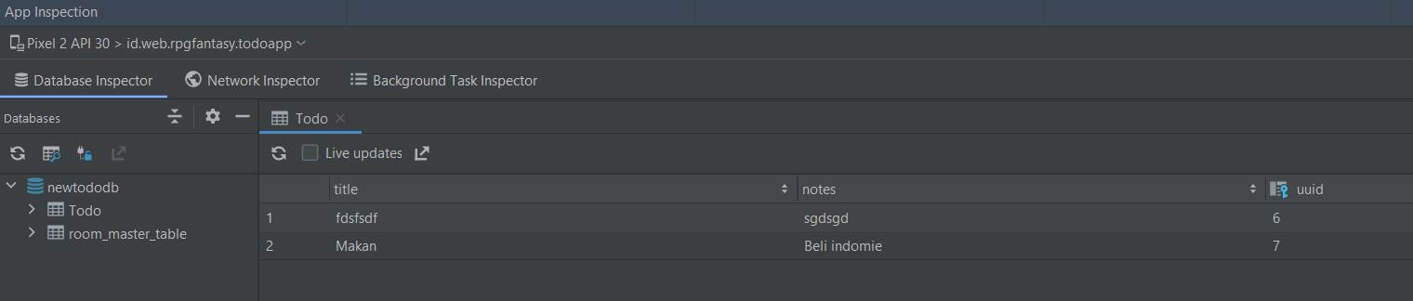
Check With Database Inspector
Click on view > Tools Window > App Inspection, then select Database Inspector. Wait until it is fully loaded

Slide 61
7.
Handle Check Task

Slide 62
Handle Check Task
To clear a todo task, user simply press the checkbox in particular todo
We already have clearTask function in ViewModel
However the problem is how to call this function within adapter?
Solution: interface callback or passing Lambda function

Slide 63
Passing Lambda Function
Utilize the power of Kotlin
In Adapter class we can pass a custom Lambda Function as in constructor definition.
class TodoListAdapter( val todoList:ArrayList<Todo>, val adapterOnClick : (Todo) -> Unit)
:RecyclerView.Adapter<TodoListAdapter.TodoViewHolder>() {

Slide 64
Passing Lambda Function
And call this function if user click on the checkbox
override fun onBindViewHolder(holder: TodoViewHolder, position: Int) {
holder.view.checkTask.setText(todoList[position].title.toString())
holder.view.checkTask.setOnCheckedChangeListener { compoundButton, b ->
adapterOnClick(todoList[position])
}
}

Slide 65
Passing Lambda Function
Next define the function in Fragment
class TodoListFragment : Fragment() {
private lateinit var viewModel:ListTodoViewModel
private val todoListAdapter = TodoListAdapter(arrayListOf(),
{ item -> viewModel.clearTask(item) })
Call ClearTask
Inside this lambda function, it safely call clearTask from viewmodel

Slide 66
Thanks!
Any questions?
You can reach me at:
andre@staff.ubaya.ac.id

